Slide 1
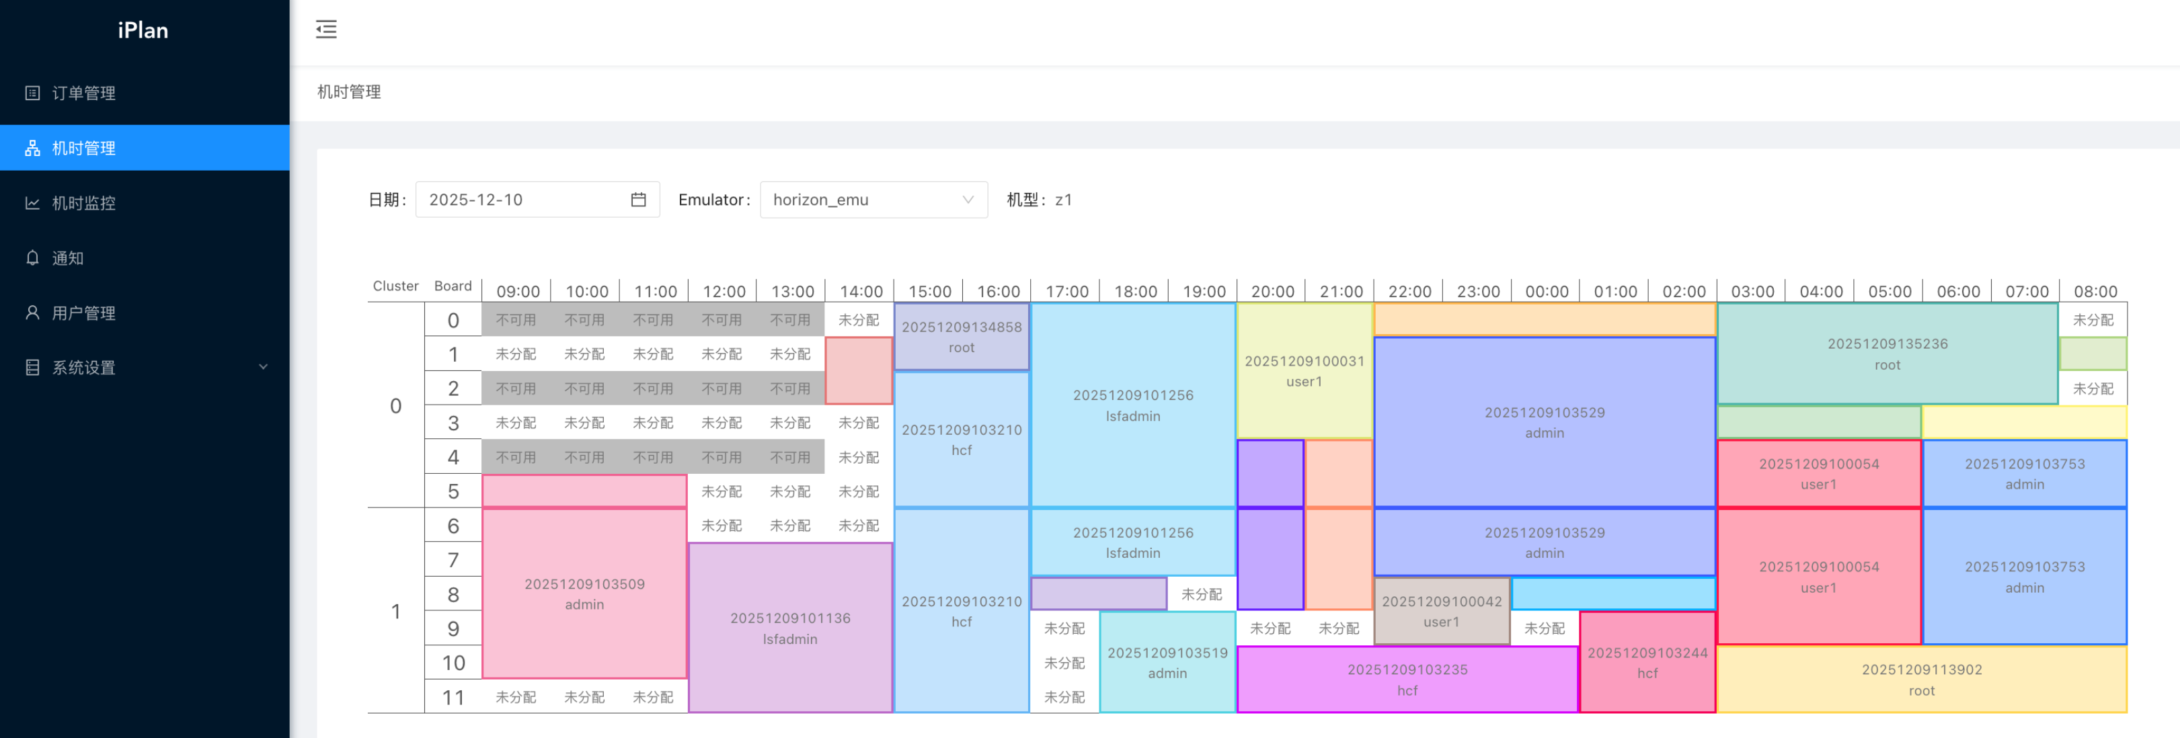
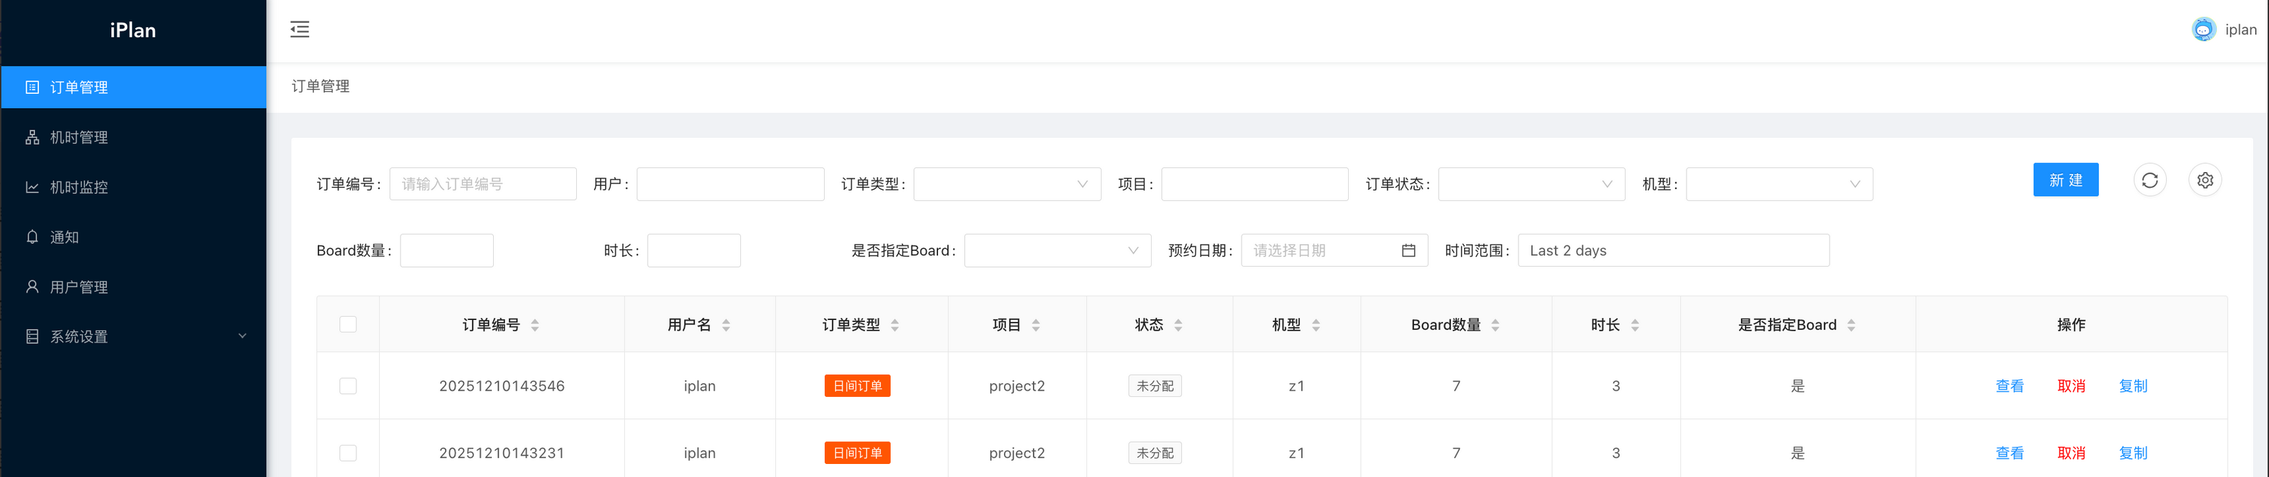
iPlan
EMULATOR TIME GOVERNANCE
Turn scarce emulator time
into a governed workflow
Reservation, explainable allocation, backfill, execution monitoring, and utilization insight for Palladium Z1/Z2 environments.
RESERVATION · ALLOCATION · EXECUTION · ANALYTICS
Palladium Z1 / Z2
Product deck · 2026

Slide 2
THE OPERATING PROBLEM
High-value emulators are often managed with low-visibility processes
The cost is not only idle hardware. Engineers lose time negotiating access, while managers lack evidence for policy and capacity decisions.
01
02
03
Conflicting requests
Opaque allocation
Idle gaps
Spreadsheets and chat threads do not enforce constraints.
Users cannot see how priority and fairness were applied.
Early release and fragmented windows are hard to reuse.
04
05
Unknown actual use
Weak planning evidence
Requested, assigned, and consumed time diverge.
Capacity decisions rely on anecdotes instead of data.
iPlan / ivyent
02

Slide 3
PRODUCT POSITIONING
One closed loop from demand to measurable utilization
REQUEST
ALLOCATE
REVIEW
EXECUTE
IMPROVE
Structured constraints
→
Priority + fairness
→
Human control
→
Observed state
→
Utilization evidence
iPlan is not a generic calendar. Allocation rules, runtime state, and reporting share one domain model.
iPlan / ivyent
03

Slide 4
CORE CAPABILITIES
Six capabilities that make the schedule operational
RS
Structured reservation
AL
Automated allocation
BF
Backfill
Device, boards/domains, time, alternatives, and project context.
Priority, project fairness, constraints, and utilization.
Recover released or fragmented capacity for eligible orders.
RT
Runtime monitoring
AC
Access control
AN
Analytics
Connect assignments to observed device and user state.
JWT, LDAP, Casbin RBAC, and permission-aware actions.
Compare requested, assigned, and consumed time.
iPlan / ivyent
04

Slide 5
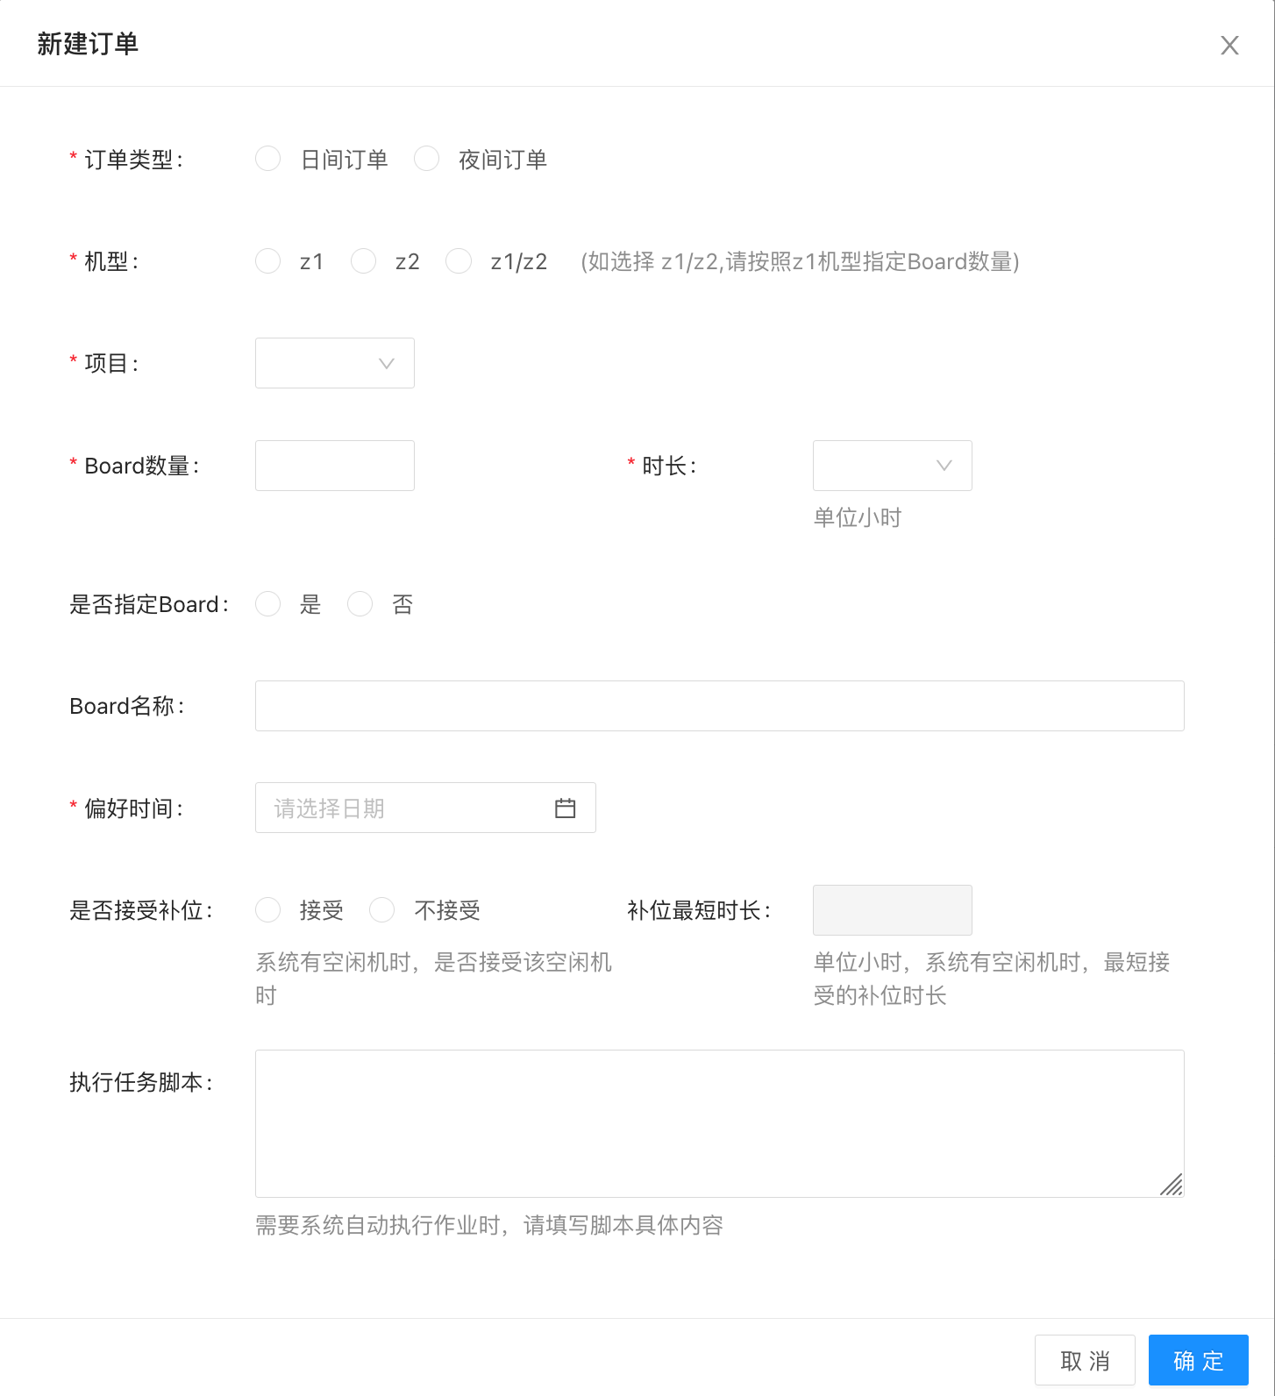
USER WORKFLOW
Capture constraints once, then let the workflow carry them
1
Submit
Project, device, capacity, time, alternatives
2
Lock
Freeze eligible requests at the cutoff
3
Generate
Build candidate allocation plans
4
Review
Explain unmatched orders and exceptions
5
Publish
Notify users and open the execution window
6
Measure
Use observed state for reporting and policy
iPlan / ivyent
05

Slide 6
ALLOCATION ENGINE
Automation that remains explainable
01
Business priority
02
Project fairness
Honor approved project and request priority.
Avoid persistent concentration of scarce capacity.
03
Constraint fit
04
Resource utilization
Respect device, capacity, continuity, and timing rules.
Reduce unusable gaps inside the allocation period.
Candidate plans remain separate from the published result, so administrators can compare options and document exceptions.
iPlan / ivyent
06

Slide 7
BACKFILL
Convert released time into a second chance to run
01
02
03
04
05
Detect
→
Qualify
→
Lock
→
Activate
→
Notify
Assigned capacity is released or becomes idle
Remaining time and hardware fit a waiting order
Transaction and row lock protect concurrent updates
Original order ends; eligible order is assigned
Users receive the updated execution opportunity
Measure success rate and response time in the customer environment; do not assume a universal utilization gain.
iPlan / ivyent
07

Slide 8
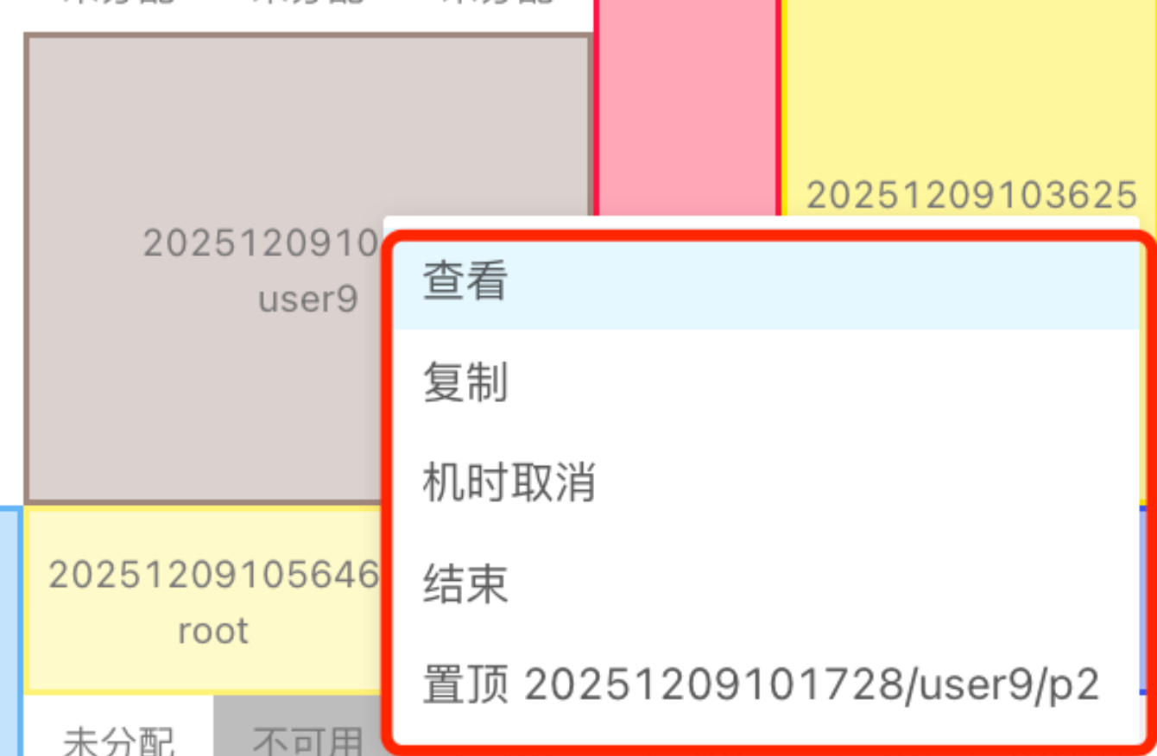
VISIBILITY
See the full day before changing the schedule
Device and board/domain occupancy
Neighboring assignments and conflicts
Permission-aware context actions
One view for users and administrators
iPlan / ivyent
08

Slide 9
GOVERNANCE & INSIGHT
Different roles, one source of operational truth
ROLES
INSIGHTS
Engineer
Submit, track, and use an assignment
01
02
Requested vs. assigned
Assigned vs. consumed
Project lead
Review fairness and demand patterns
03
04
No-shows and early release
Device / project / user trends
Administrator
Control plans, exceptions, devices, and policy
Management
Use utilization evidence for capacity decisions
Requested → Assigned → Consumed
iPlan / ivyent
09

Slide 10
ARCHITECTURE
On-premises, modular, and designed for enterprise integration
Experience
Web UI + REST API
Access
JWT · LDAP · Casbin RBAC
Domain
Orders · Plans · Results · Backfill
Runtime
Worker · Collectors · gRPC
Data
MySQL / PostgreSQL / SQLite · Redis / Badger
Go 1.24+ · Gin · GORM 2 · Wire · Zap · TOML · Cron
iPlan / ivyent
10

Slide 11
PROOF OF CONCEPT
Prove the operating model with real constraints
Automatic assignment rate
How much routine planning is automated
Manual exception rate
Where rules still miss business reality
Idle device time
Recoverable waste before and after
Backfill success
How often eligible spare capacity is reused
Assigned vs. consumed
No-shows and estimate quality
Planning effort
Operator time per allocation cycle
Inventory & baseline → configure one period → shadow scheduling → controlled production cycle
iPlan / ivyent
11

Slide 12
iPlan
Make every emulator hour
accountable
Start with one representative allocation period and measure the difference.
REQUEST
→
ALLOCATE
→
IMPROVE
On-premises · Explainable · Measurable
Discuss an iPlan POC
info@ivycomputing.com · ivycomputing.com/iplan.html

